Slide 1
Year End Picnic
Sunday July 28th

Slide 2
Details
Date: Sunday July 28th
Time: 4:00pm – 7:00pm
Location: KRP Community Hub at Mitel
All members of the Kanata Dragons and their families are invited!

Slide 3
Directions to Mitel
Address: 350 Leggett Drive, Kanata, K2K 2W7
From Queensway
Take March Road north.
Turn right at Carling Avenue.
Turn left onto Schneider Road.
Turn left onto Leggett Drive.
Enter employee parking lot on your left.
From Morgans Grant
Take March Road south.
Turn left onto Solandt Road.
Turn right onto Leggett Drive.
Enter employee parking lot on your right.

Slide 4
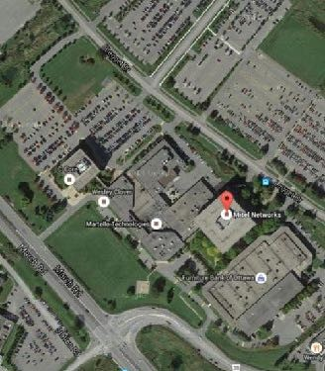
Parking at Mitel
1. No entry from March Road.
4
2. No entry from Carling Avenue.
3
3. Enter employee parking lot from Leggett Drive and park in the employee parking lot.
1
4. Walk to the party site.
2

Slide 5
Accessible Parking
The front row of the parking lot is reserved for accessible parking.

Slide 6
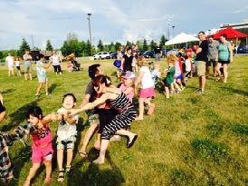
Schedule of Events
4:00pm - 4:45pm: Meet Dezzy the Dragon
4:00pm - 5:00pm: Fire Truck Visit
5:00pm – 5:30pm: Tug of War
5:00pm – 5:40pm: Magic Show
6:30pm – 7:00pm: Dezzy’s Dance Party

Slide 7
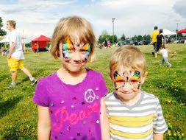
Games and Activities
The following games and activities will run from 4:00pm – 6:30pm:
Face painting*
Moon Bounce
Mega Slide
Sports Obstacle Course
Carnival games
Foosball
*Face painting costs $5. All other activities are free!

Slide 8
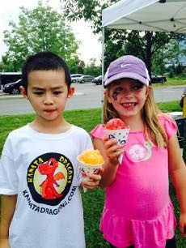
Food & Beverage
Sorry, but there will be no BBQ this year.
We recommend that you bring a picnic!
An ice cream vendor will be on site.
We will also sell the following:
Snow cones
Cotton candy
Water
Chips
Gatorade

Slide 9
Volunteers Needed!
We are looking for volunteers to help with the carnival games. If you can donate 30 minutes to help with the games, please let us know!
Send your email to admin@kanatadragons.com.

Slide 10
Don’t Forget Our August Program!
Visit the Kanata Dragons web site to register for our 5-week August Program on the artificial turf at the Richcraft Complex.
The program starts on Tuesday August 6th or Wednesday August 7^{th.}

